Slide 1








AZIENDA OSPEDALIERO - UNIVERSITARIA PISANA
U.O. ENDOCRINOLOGIA 1
Direttore Prof. Ferruccio Santini
Sezione Centro Obesità e Lipodistrofie

Slide 2

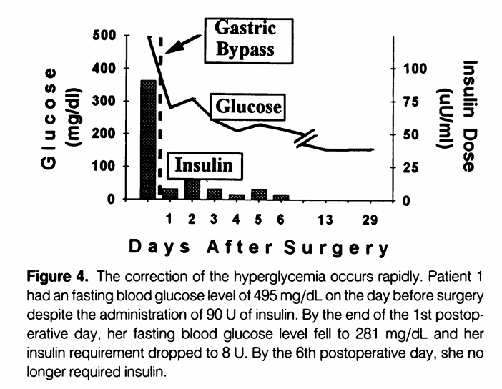

Slide 3

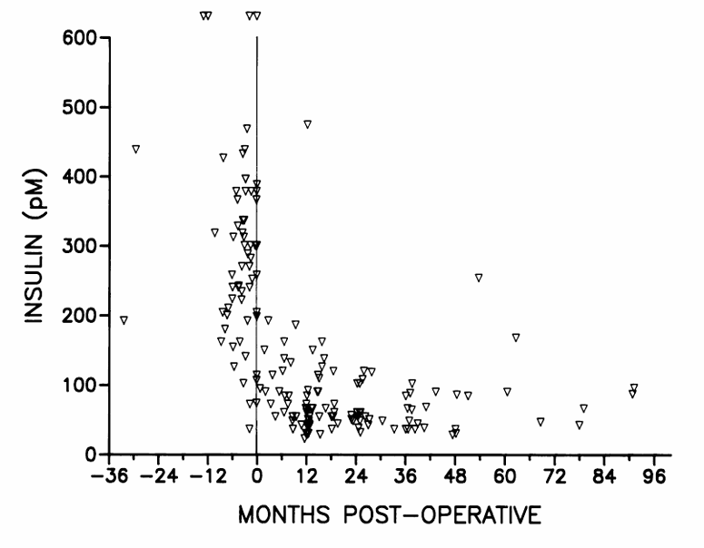
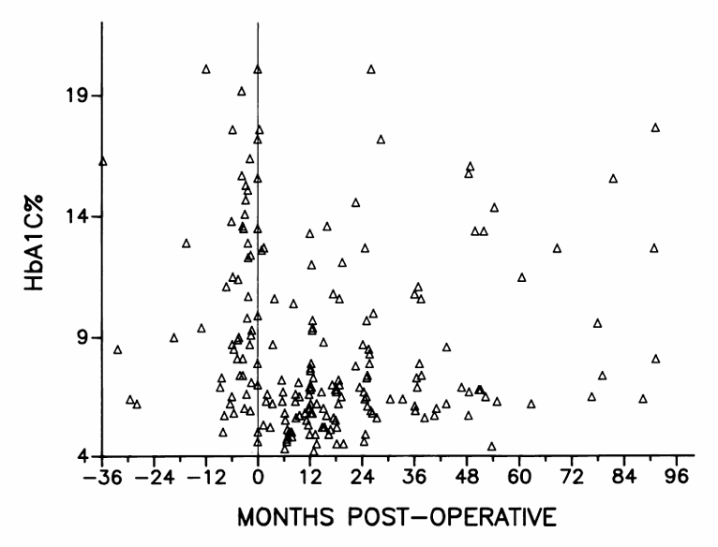

Slide 4

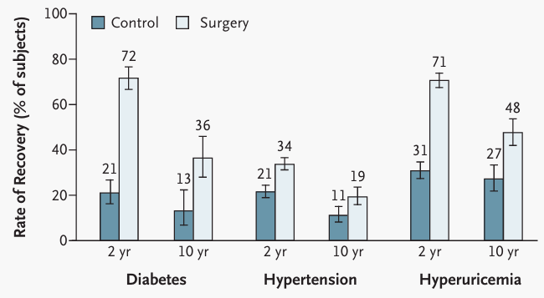


Slide 5
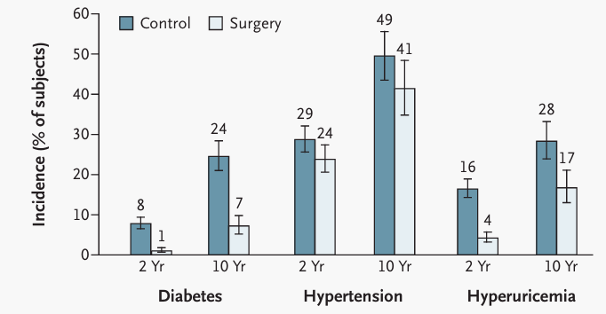

Slide 6

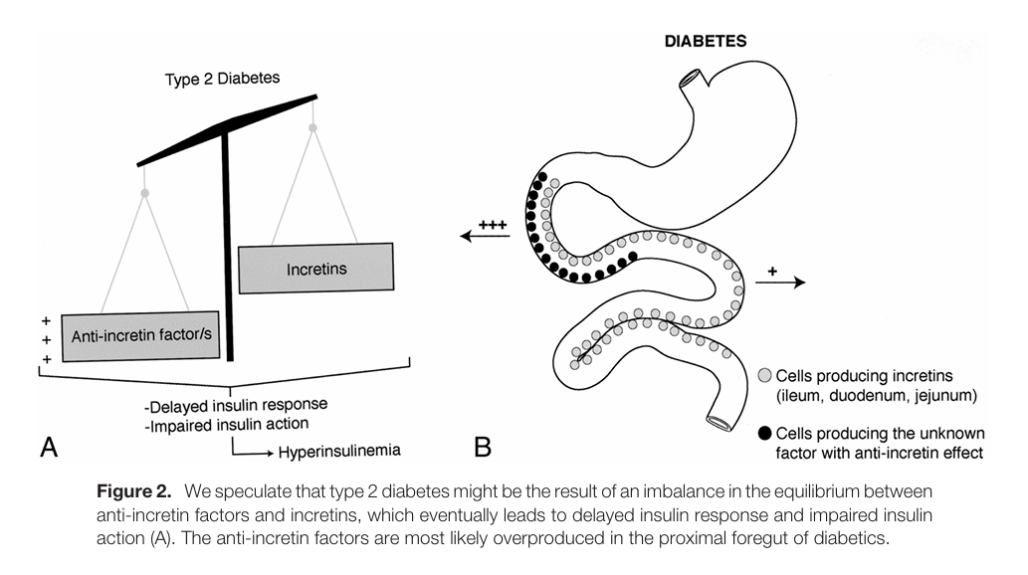


Slide 7

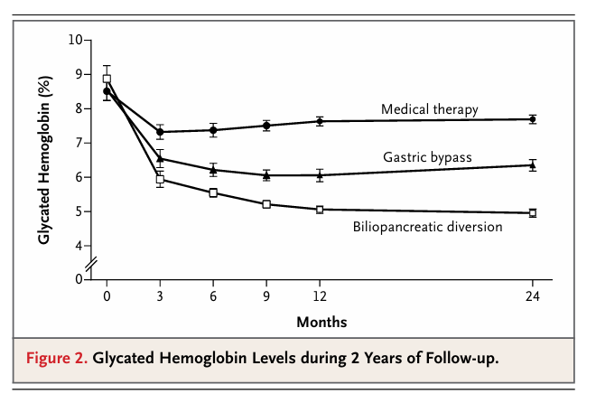
2012

Slide 8

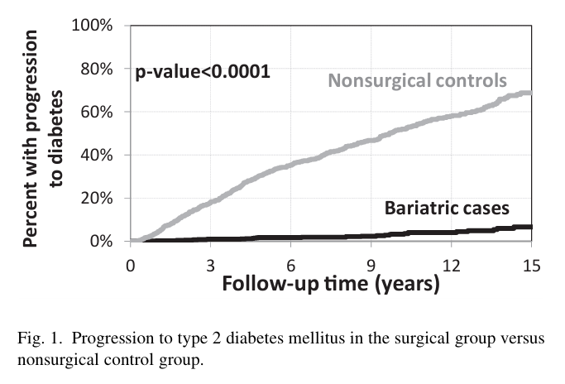


Slide 9
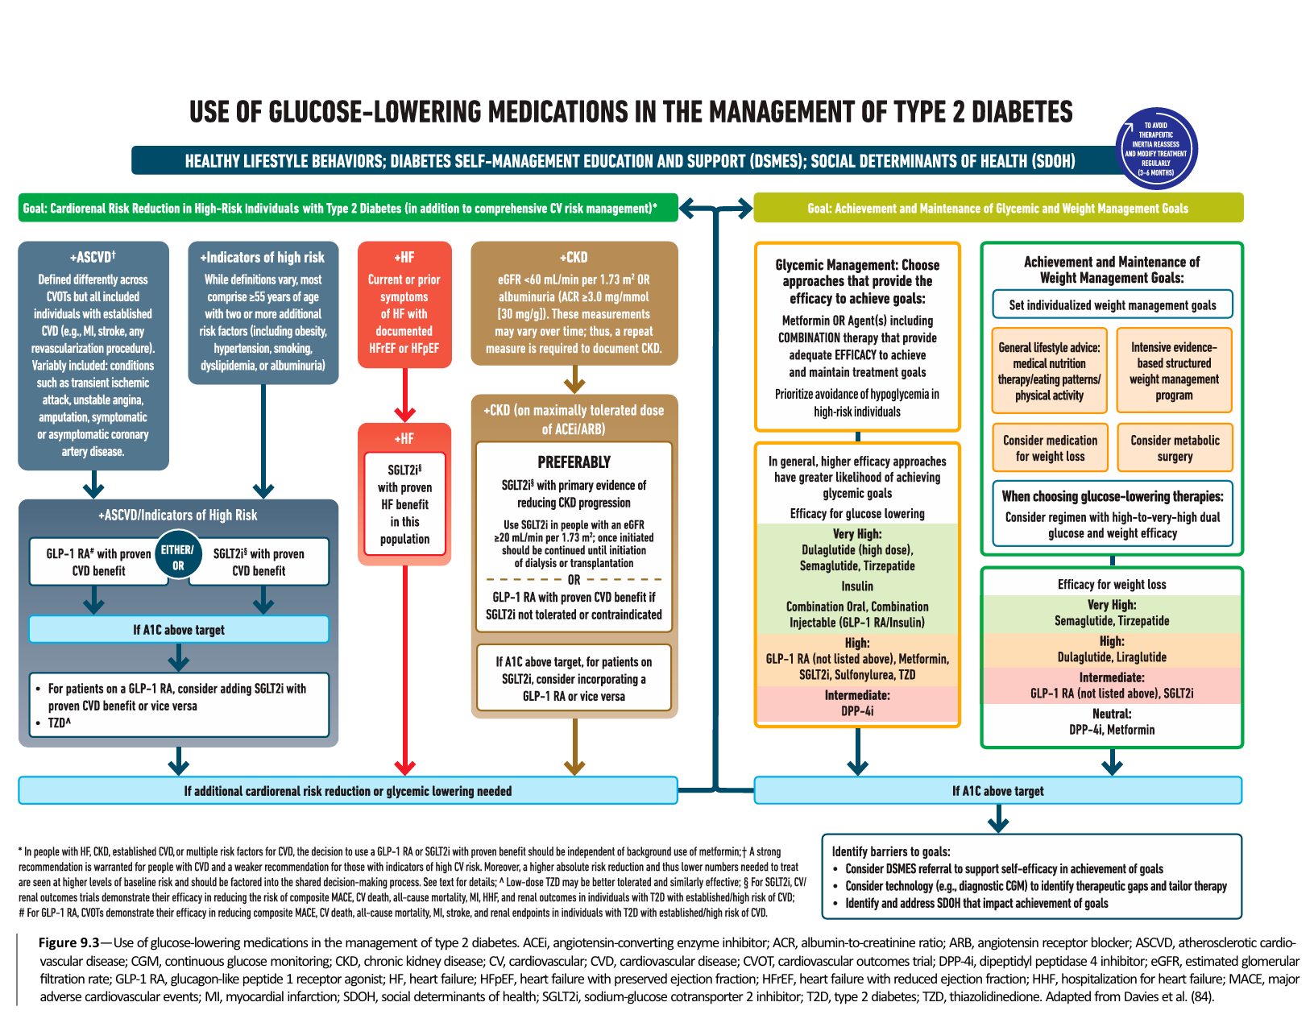



Slide 10
Advantages of surgical treatment of type 2 diabetes compared to pharmacological therapy
Single procedure with long-lasting outcomes
Multiple benefit including significant
and sustained weight loss
Reduced long-term costs

Slide 11
Grazie

